Slide 1

DESIGN AND IMPLEMENTATION OFAUTOMATED SALARY PAYROLL SYSTEM (CASE STUDY OF CRUTECH) PRESENTED BY AKPAN, MICAH MONDAY 13/CSC/098

Slide 2
STATEMENT OF PROBLEM FACED BY EXISTING SYSTEM
Time: Lot of time is taken for the Manual computing of staff data/information.
Problem in computing: Error can be made through the manual computing of staff data/information, which can affect the finances of staff.
Manual checking of employees deductions and generate the essential report
Inaccurate reports on employee income and paychecks, in a situation where a staff get overpay or underpay

Slide 3
SPECIFIC OBJECTIVE
To reduce the manual time in computing staff details, providing fast computing of staff information.
Providing accurate report of staff details (correct report on staff activity).
Automated checking of employees deductions and generating the essential report
Providing accurate report on staff income and paychecks.

Slide 4
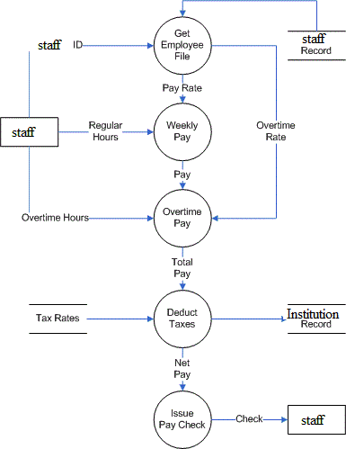
HIGH LEVEL MODEL OF PROPOSED PAYROL SYSTEM

